Slide 1

Verilog HDL (Test and Verification)
Winter 1400 (Computer Aided Design)
Meisam Abdollahi
School of Computer Engineering
Iran University of Science and Technology
meisam.abdolahi@ut.ac.ir

Slide 2
Testbench
Verilog simulation environments provide tools for graphical or textual display of simulation results.
Some simulation environments go further, and provide graphical tools for editing input test data to a design module. )waveform editors(
Such tools are usually good for small designs. They become too complex to use for a design with many busses and control signals.
Each simulation environment uses a different procedure for waveform editing, and moving from one simulator to another requires relearning a whole new set of procedures.
This problem can be alleviated by use of Verilog testbenches.
A Verilog testbench is a Verilog module that instantiates an MUT, applies data to it, and monitors its output.

Slide 3
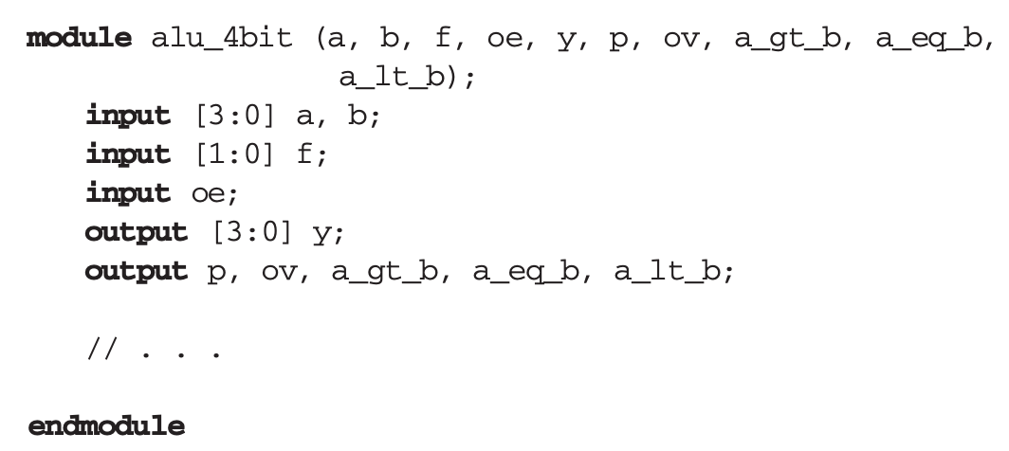
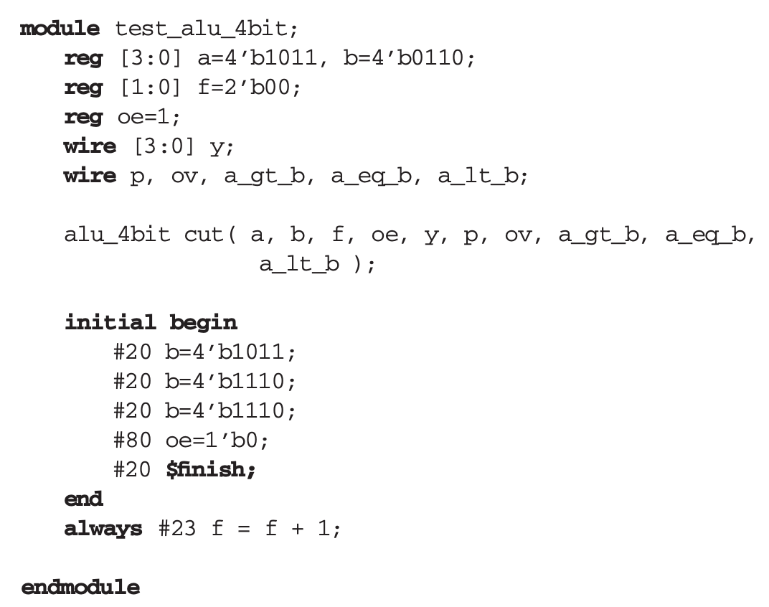
Testbench
Developing a testbench for circuit is straight forward, however selection of data and how much testing should be done depends on the MUT and its functionality.

Slide 4
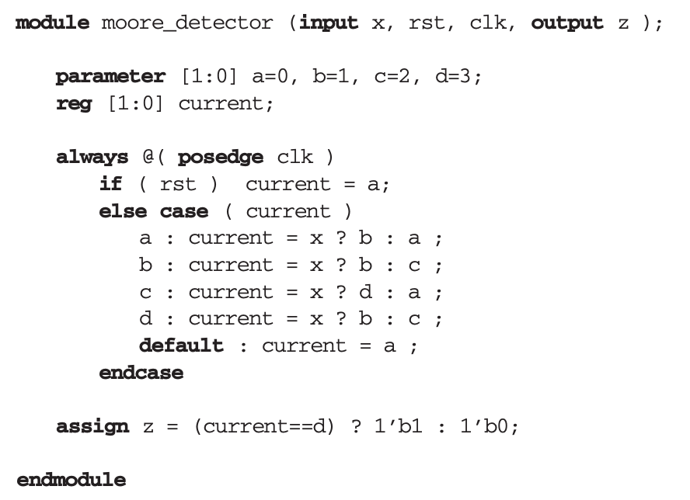
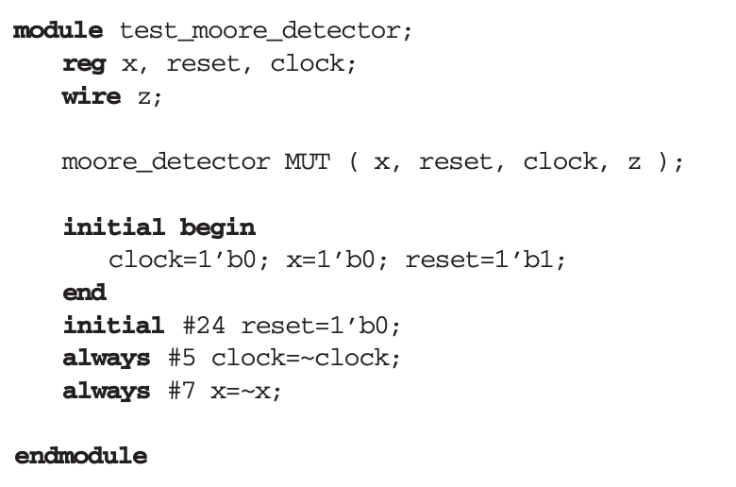
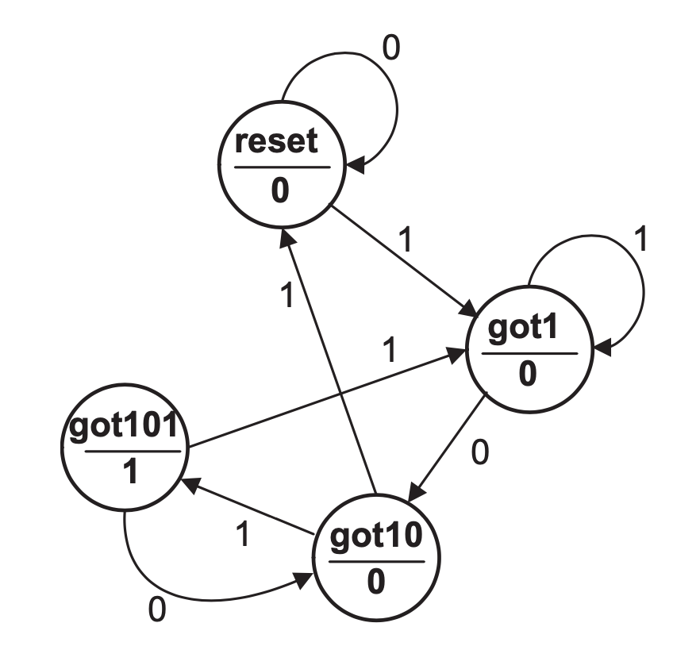
Testbench Techniques

Slide 5
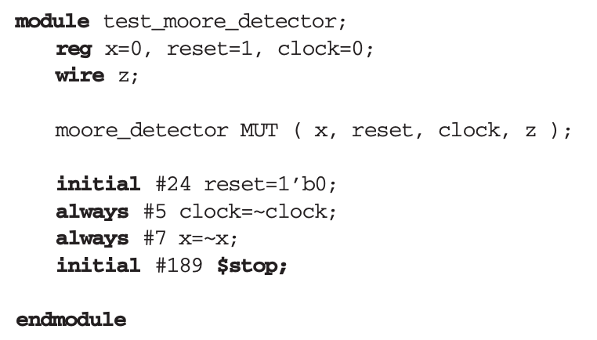
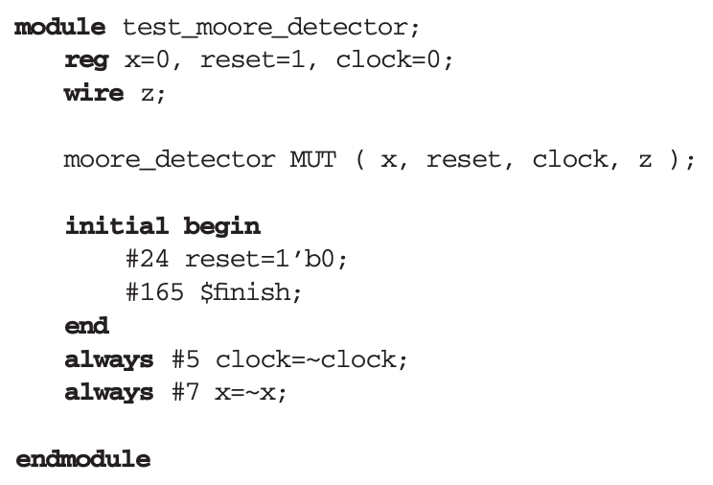
Simulation control
A stopped simulation can be resumed, but a finished one cannot.

Slide 6
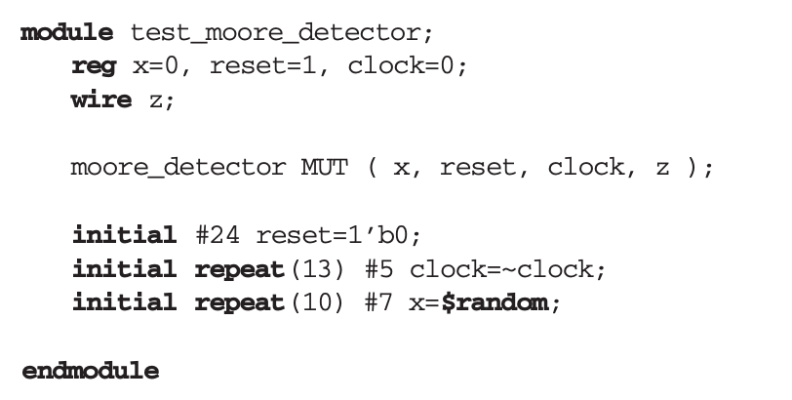
Limiting data sets
Instead of setting simulation time limit, a testbench can put a limit on the number of data put on inputs of a Module Under Test (MUT).

Slide 7
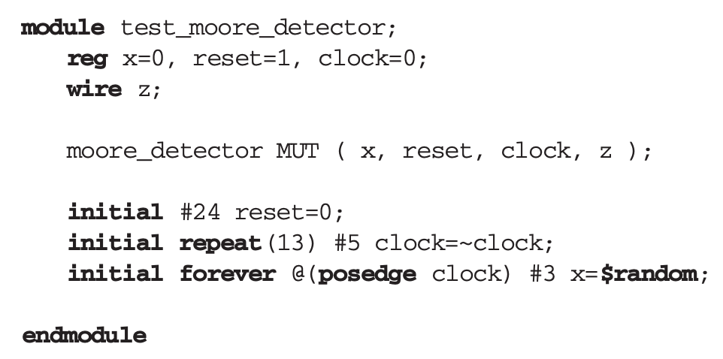
Applying synchronized data
Where several sets of data are to be applied, synchronization of data with the system clock becomes difficult.
Changing the clock frequency would require changing the timing of all data inputs of the module being tested.
This technique of data application guarantees that changing of data and clock do not coincide.
Synchronizing Data with Clock

Slide 8
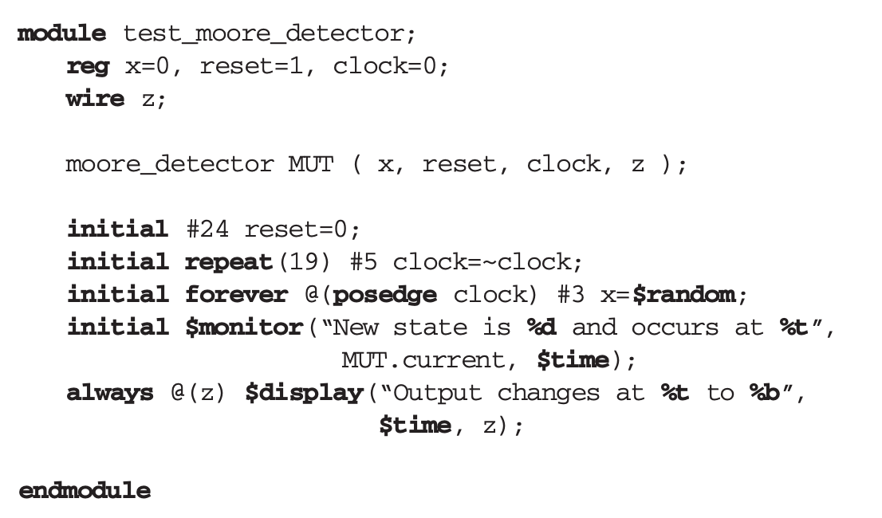
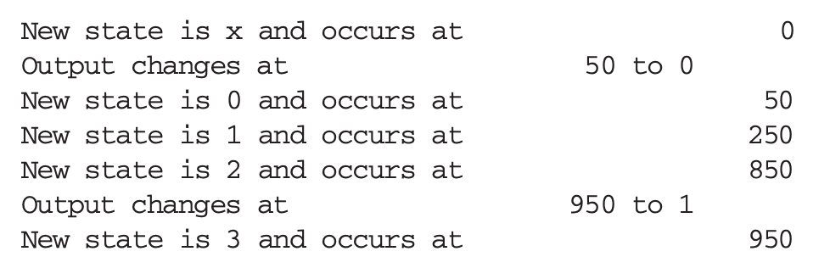
Synchronized display of results
%h, %H | Display in hexadecimal format
%d, %D | Display in decimal format
%b, %B | Display in binary format
%t, %T | Display in time format
%f, %F | Display 'real' in a decimal format
$display: print the immediate values
$strobe: print the values at the end of the current timestep
all simulation events in the current time step have executed
$monitor: print the values at the end of the current timestep if any values changed.

Slide 9
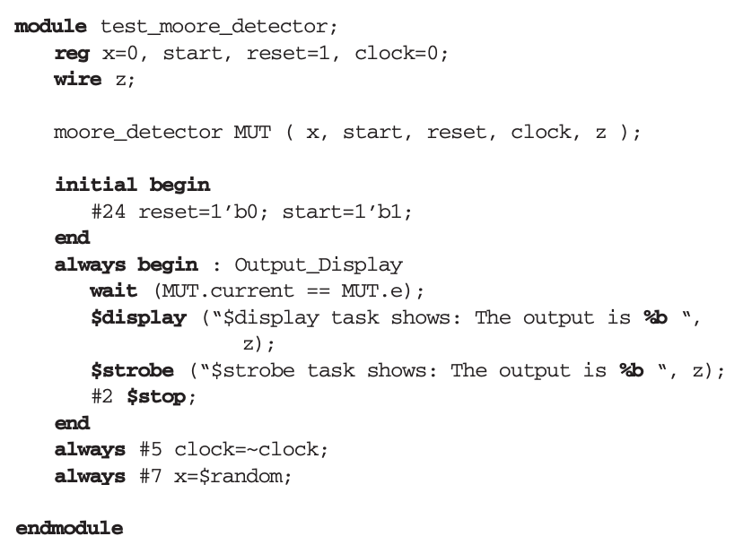
An interactive testbench

Slide 10
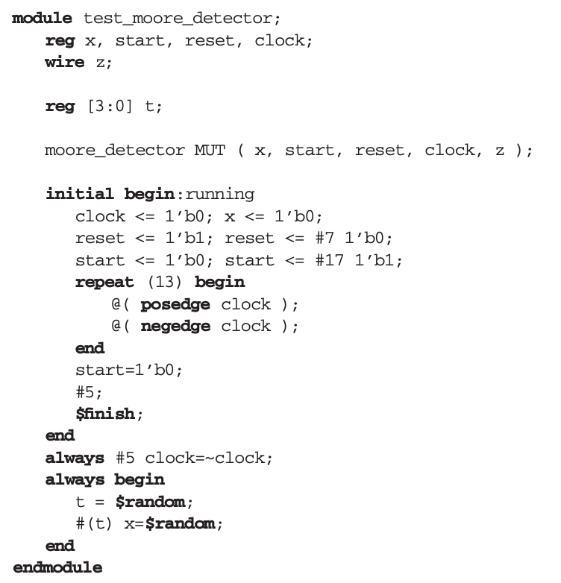
Random time intervals

Slide 11
Design Verification
Formal verification is a way of automating design verification by eliminating testbenches and problems associated with their data generation and response observation.
In formal verification, a designer writes properties to check his or her design.
Formal verification tools do not perform simulation, but come up with a Yes/No answer for every property the design is being checked for.
Although this method of design verification helps discover many design errors, most designs still need testbench.
Instead of eliminating data generation and response observation, we can reduce or eliminate efforts needed for analyzing output responses using assertion verification.
Assertion verification adds monitors to a design to improve its observability.
While the design is being simulated with its testbench data, assertion monitors continuously check for correct design behavior by validating the properties.

Slide 12
Assertion Verification
Unlike simulation that a testbench or a human has to interpret the results, in assertion verification, in-code monitors take the responsibility of issuing a message if something happens that is not expected.
In Verilog, these monitors are modules, and they are instantiated in a design to check for certain design properties.
this kind of module is like an always-active procedure that continuously checks for events.
The set of assertion monitors are available in a library that is referred to as open verification library (OVL).
Designers can develop their own set of assertions, and use them in their designs.

Slide 13
Assertion Verification
The existing monitors check for values of signals, relation of several signals with each other, sequence of events, and expected patterns on vectors or groups of signals.
For using assertions, a designer compiles OVL and his or her own assertion library into a simulation library and makes this library available to designs being verified.
When a design is developed, assertions are placed at key points in the design to check for key functionalities. When the design is being simulated the monitors check signals for their expected values.
If a signal does not have a value expected by a monitor, the assertion monitor displays a message and the time that the violation of the property has occurred.

Slide 14
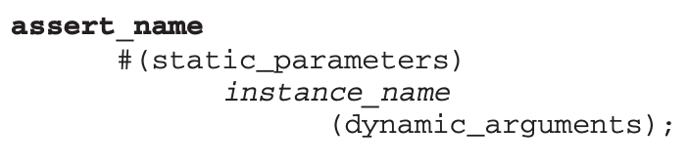
Open Verification Library
such as severity of failure, vector size, number of clocks, time frame specification (in terms of clock cycles), and the displayed failure message.
Dynamic arguments are module ports and are also referred to as assertion ports
Reference clock, starting signal, reset signal, and the test expression are some of typical dynamic arguments for assertion monitors.

Slide 15
Assertion Monitors
assert_always
assert_change
assert_one_hot

Slide 16
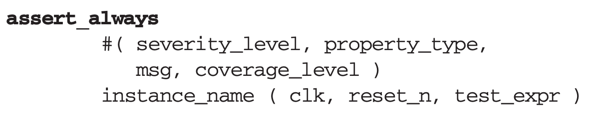
assert_always
This assertion continuously checks its test_expr to make sure it is always true on the edge of the specified clock (clk).
If the test expression fails, the assertion fires and its corresponding message (msg) is displayed.
severity_level: Severity of the failure (default is 0).
Property_type: Property type. Default: ‘OVL_ASSERT (default is 0).
msg is a string expression displayed whenever the assertion fails.
coverage_level is for coverage monitoring for the checker. The default value is “0”.
Level one is associated with the basic coverage representing the triggering condition(s) of the checker.
Level two provides coverage of ranges of values.
Level three represents coverage of corner cases of data, latencies, delays

Slide 17
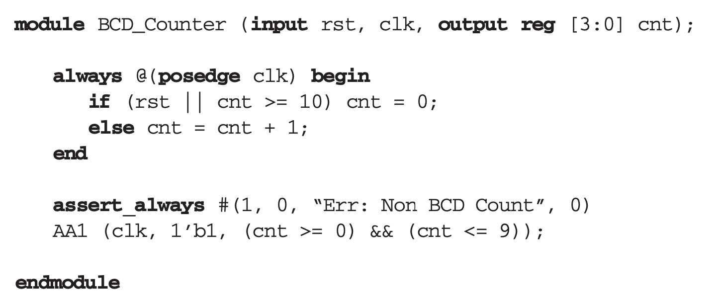
assert_always: Example

Slide 18
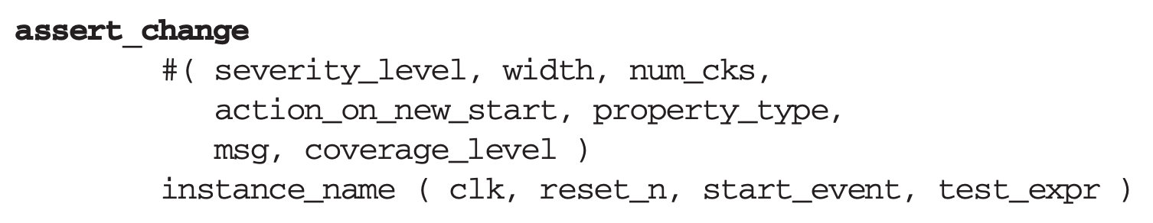
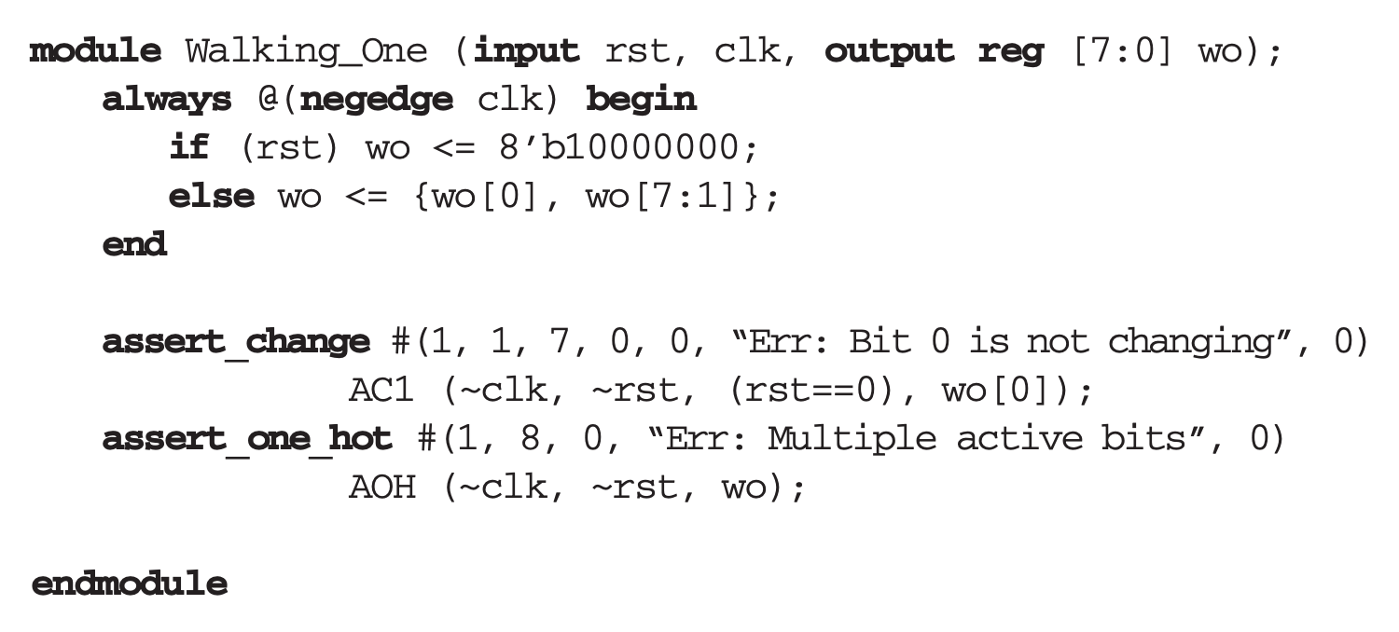
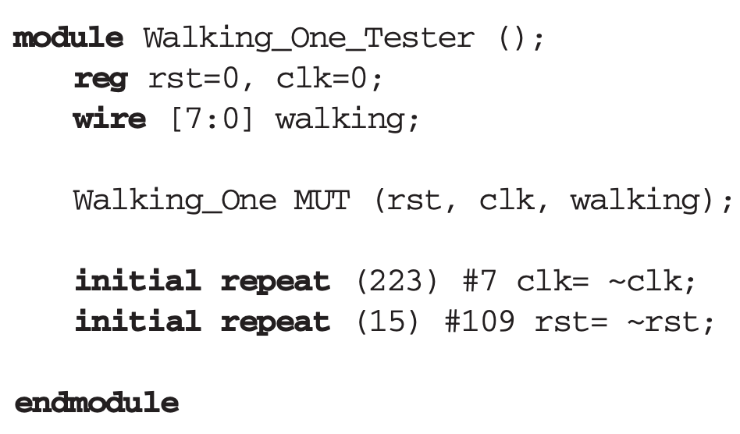
assert_change
width of the test_expr argument. Default: 1.
num_cks: Number of cycles to check for a change in the value of test_expr. Default: 1.
action_on_new_start: Method for handling a new start event Default: ‘OVL_IGNORE_NEW_START (0).

Slide 19
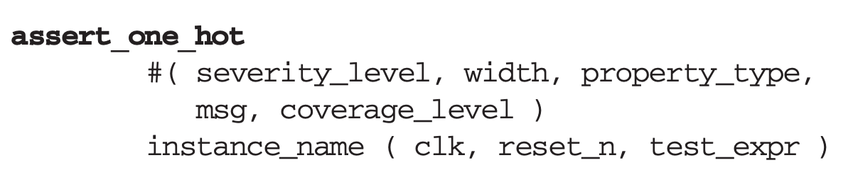
assert_one_hot
The assert_one_hot assertion monitor checks that while the monitor is active, only one bit of its n-bit test expression is 1.

Slide 20
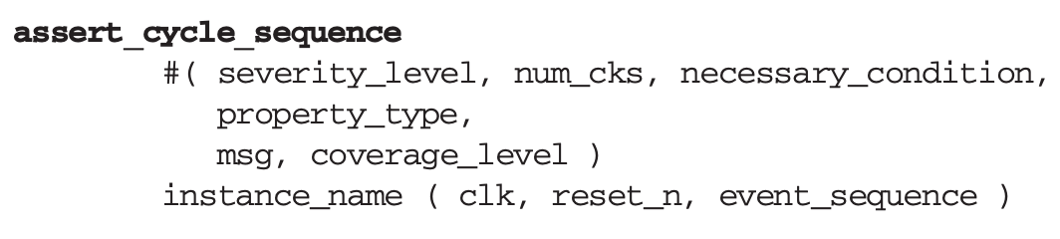
assert_cycle_sequence
The assert_cycle_sequence shown below is a very useful assertion for verifying state machines.
This assertion checks for a sequence of events in a given number of clocks.

Slide 21
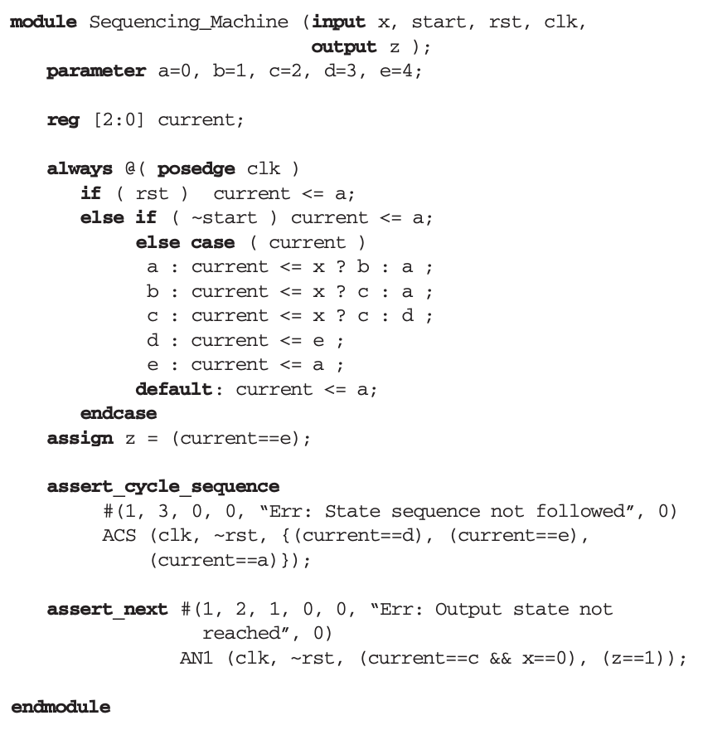
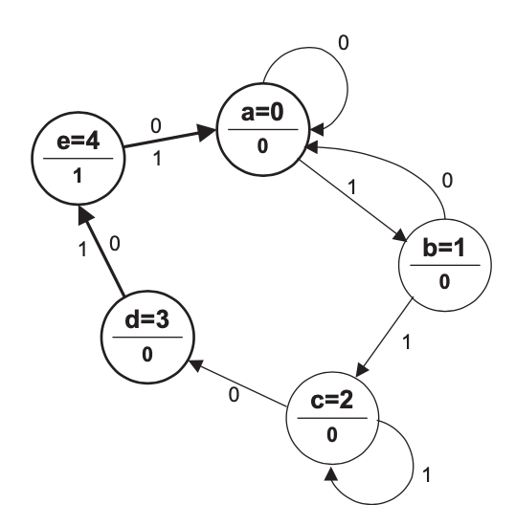
assert_cycle_sequence: Example

